Slide 1
Biomedical Natural Language Processing
MMCi Block 4
Matthew Engelhard
Notes:
NEED INFO ABOUT ROC, CONFUSION MATRIX, ETC HERE

Slide 2
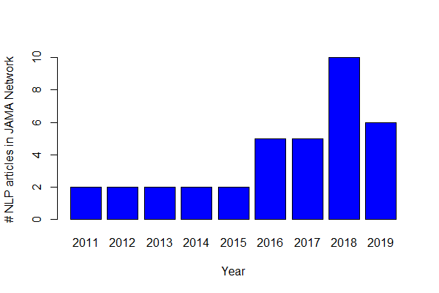
A Survey of NLP in JAMA…
Notes:
Originally looked like 38 research articles
Very rigorous search…
These are papers that mention NLP
Can see that numbers are going up, expect 2019 to be twice again what we saw in 2018
But, what you’ll find is that most of these are not NLP in the way David described…

Slide 3
A Survey of NLP in JAMA…
1 uses word vectors
28 research
articles
28 use word counts or frequencies
The majority of these search only for a limited number of keywords or expressions
Notes:
Originally looked like 38 research articles
28 are doing NLP – the remaining 10 are talking about NLP in limitations, etc
Only 1 using neural word embeddings (word2vec)
- The others are using older approaches
There are a number of reasons for this – one is medical jargon -- as you saw, pre-trained word embeddings use a dictionary that associates each word with a vector
In medicine, not all of the relevant words may be present… shorthand and abbreviations are a challenge… and the context may be quite different. Remember that word embeddings are learned based on the context in which they tend to be found. In medicine, this may be quite different
**But more than that, it’s just time.
Instead, we see many ad-hoc, rule-based systems, etc

Slide 4
NLP in Medicine So Far:
MOSTLY BAG OF WORDS!
Notes:
Begin with what’s happened in medicine so far – this will be half – and they we’ll talk about what to expect

Slide 5
A Survey of NLP in JAMA…
4 utilize EHR text features in predictive models (e.g. mortality)
28 research
articles
20 identify specific diagnoses or medical events from the EHR
4 identify other care-related information in the EHR
0 interpret words
in context
Notes:
Originally looked like 38 research articles
** None are looking directly at patient provider conversations… yet… or assisting with clinical workflow… yet
But the vast majority are simply using NLP to do things like use keywords + ICD-9 codes to refine a computable phenotype
Importantly, these models aren’t (YET) interpreting words in context. And this is where the major opportunity lies… and has facilitated question answering, text generation, etc

Slide 6
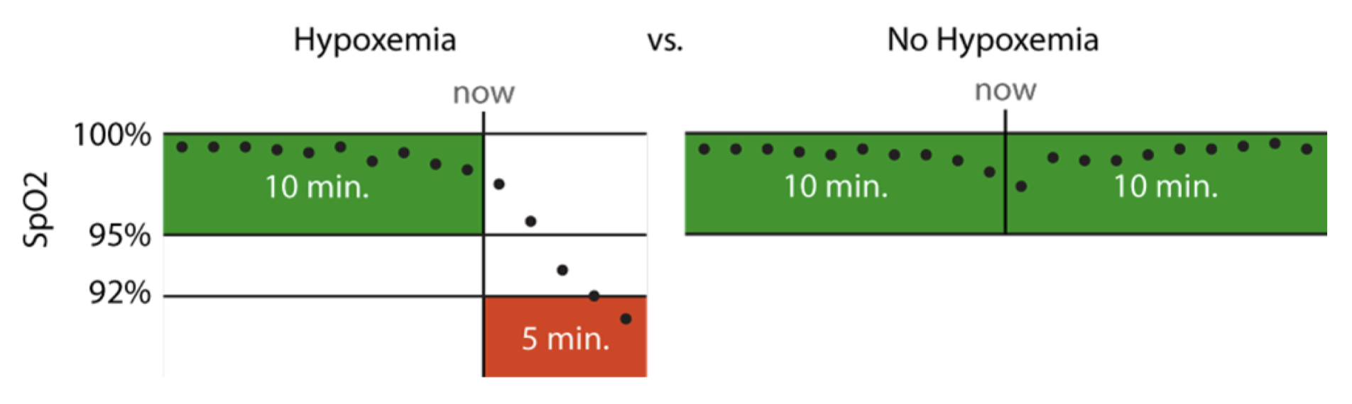
Hypoxemia Prediction during Surgery
Real-time Prediction Task:
hypoxemia (yes/no) in the next 5 minutes
based on data from the Anesthesia Information Management System
static features + real-time features collected up to that time point
Notes:
5 min window: long enough to allow an anaesthesiologist to intervene, but short enough to represent near-term risks that would benefit from immediate attention
This is actually what’s used for the anesthesiologist comparison
Model training was less strict

Slide 7
A majority of features are keyword counts
Notes:
They are not necessarily the most informative features…
But they are the largest portion by the numbers

Slide 8
Scoring Dimensional Psychopathology
Expert-generated terms for each dimension
(e.g. angry)
Final list of terms for each dimension
+
Similar terms
from DSM-IV
(e.g. hostility)
Filter by association in clinical notes
McCoy Jr, Thomas H., et al. "High throughput phenotyping for dimensional psychopathology in electronic health records." Biological psychiatry 83.12 (2018): 997-1004.
Notes:
‘negative valence’ – words indicating anger, fear, etc
‘positive valence’ – words conveying happiness, joy, etc
The point here – it’s a complicated way of identifying a list of keywords for automated scoring
Expert curated terms
Identify related words using a measure of similarity between vector representations
Use a logistic regression model to determine which of the larger set of terms are predictive of expert-curated terms in small subsamples of notes (500)
Then they simply score based on presence or absence of the larger set of terms
But again, this isn’t about natural language understanding – key distinction is models that are working on the sentence or document level rather than the word level, and that are operating based not just on individual words, but on words in context

Slide 9
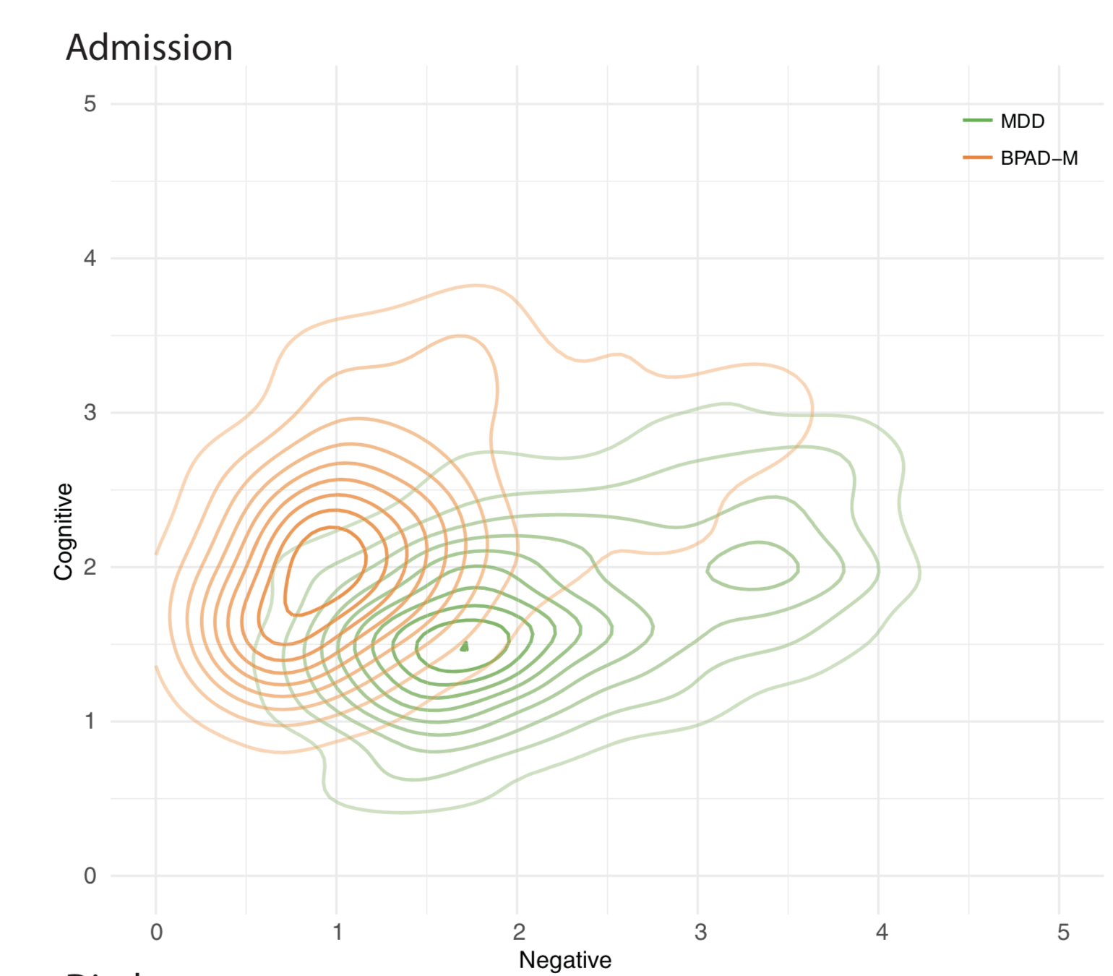
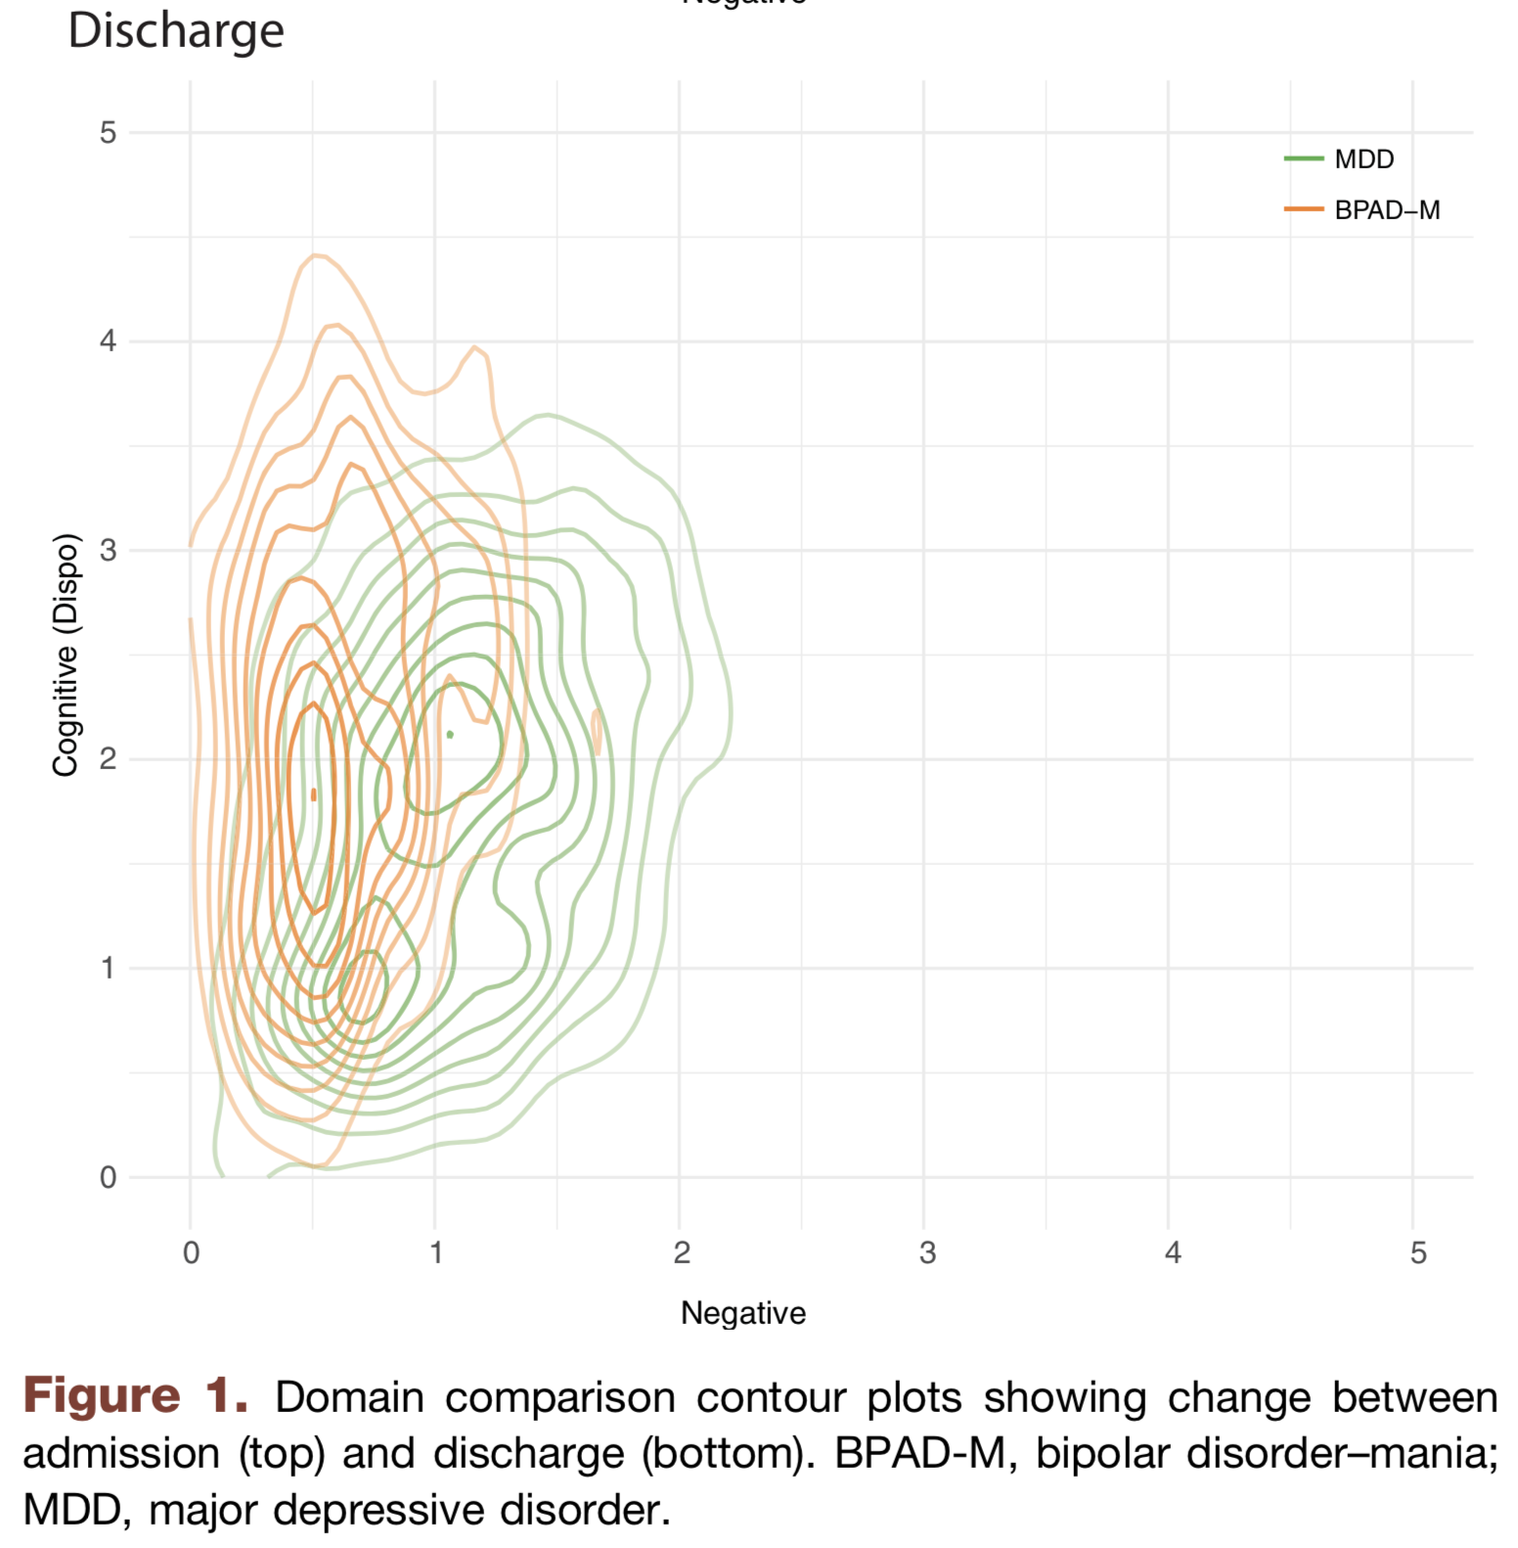
Trends in psychopathology during stay
McCoy Jr, Thomas H., et al. "High throughput phenotyping for dimensional psychopathology in electronic health records." Biological psychiatry 83.12 (2018): 997-1004.
Notes:
‘negative valence’ – words indicating anger, fear, etc
‘positive valence’ – words conveying happiness, joy, etc
The idea – have an automated method for identifying severity of dimensions of psychopathology
Then, use their score to look at descriptive statistics – i.e. admission / discharge trends and changes -- based on different psych dimensions
Able to do this at scale – paper looks at narrative clinical notes from 3619 individuals with 4623 hospital admissions
And change in these scores between admission and discharge

Slide 10
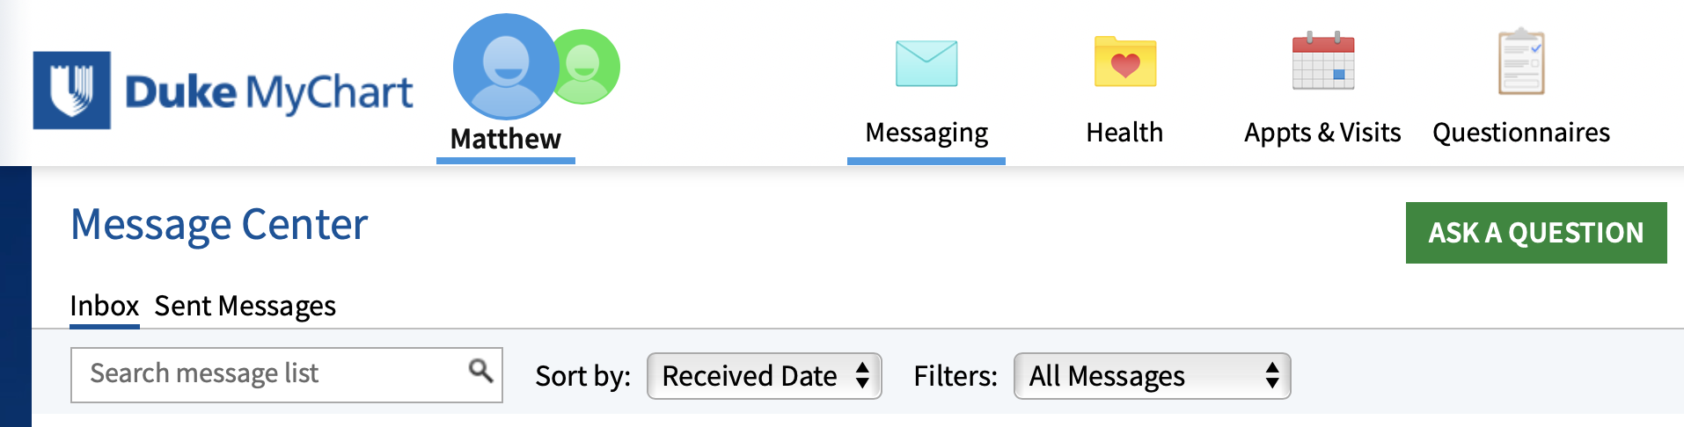
Suggested Email Responses
Notes:
Flooded with email
Not reimbursed
In the evening
Imagine a system that presents generated text that you can edit, or suggests multiple possible responses
Or “triages” messages to identify the important ones or categorize them
Seeing this happen with suggested responses in Gmail

Slide 11
Global Maternal Health
Maternal Health HelpDesk:
2 million women connected to NDoH staff via SMS
https://www.praekelt.org
Binary Classification: Urgent Message? (Yes/No)
Notes:
F1-score is harmonic mean of the two

Slide 12
Conclusions
NLP is approaching human performance on benchmark tasks like question answering
Text data are central to clinical medicine, so the potential for NLP impact is high
We can use word counts to turn text samples into vectors that we already know how to work with
The techniques we have discussed already go beyond the majority of “NLP” found in the medical literature

